Slide 1
Civil Engineering Project
Matthew Ernst
METC 107
12.5.2017

Slide 2
My Site Layout
The area of the parking lot is about 892056 ft^2, or 20.47 acres
The parking lot is made up of four rows containing 11 columns of 26 total parking spots
This makes up a total of 1144 spots
There are also seven additional rows of parking spots located in the lower center of the area, giving 138 spots per row
This will result in a total of 966 possible spots
Along the perimeter, there are 233 spots
In front of the building, there are 8 more 26 spot sections, giving 208
Around the building, there are 62 more spots, including 26 handicapped spots TOTAL=2613

Slide 3
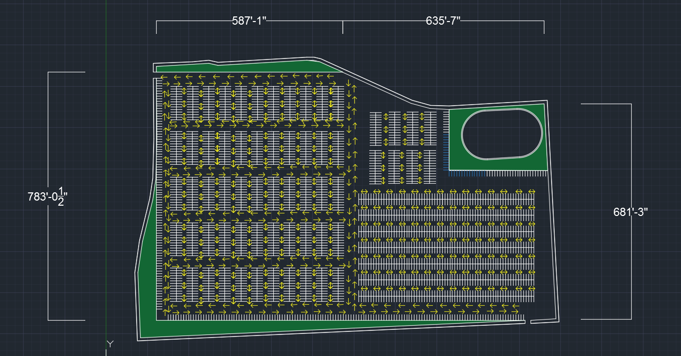
My Site Layout AutoCAD Drawing

Slide 4
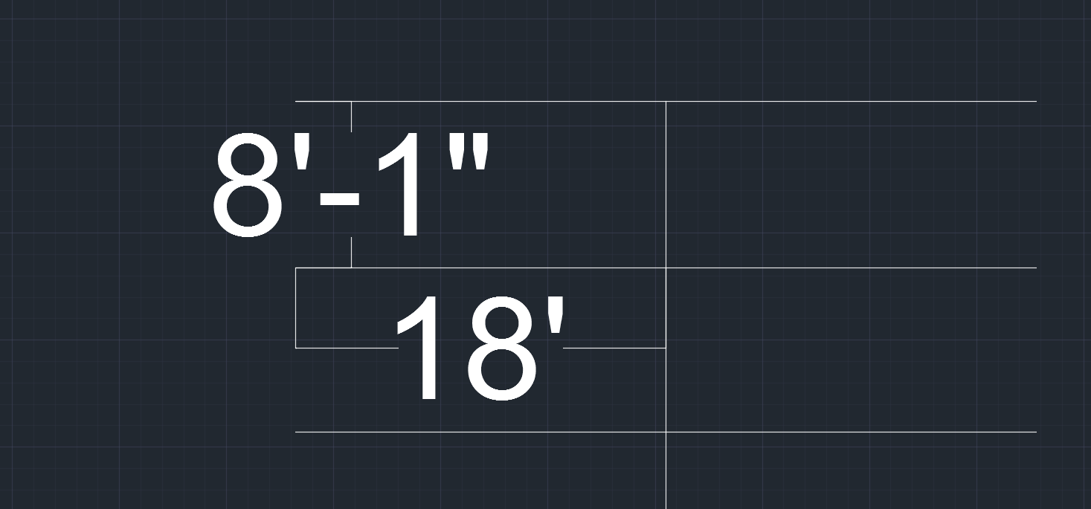
Parking Lot Dimensions

Slide 5
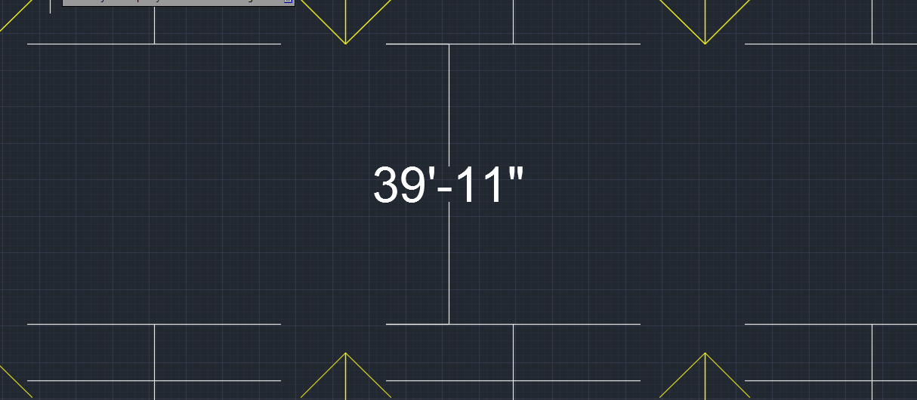
Parking Lot Dimensions

Slide 6
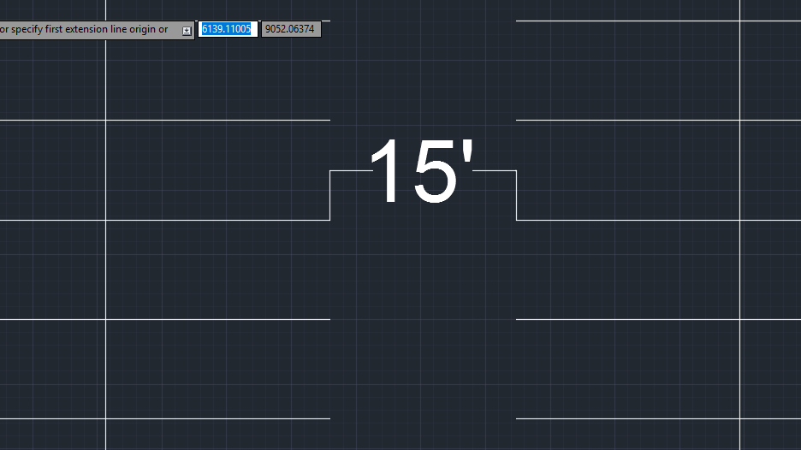
Parking Lot Dimensions

Slide 7
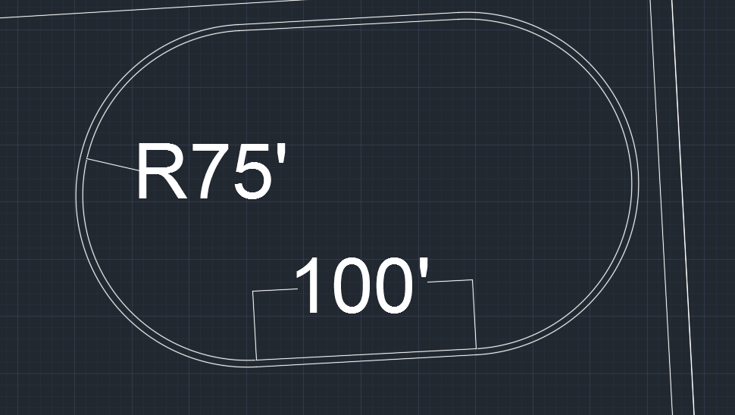
Parking Lot Dimensions

Slide 8
Disadvantages/Neat Aspects of My Design
Disadvantages
Since cars travel in any direction, the possibility for a traffic jam is high
The irregular shape of the area itself can cause difficulty with a uniform traffic flow
The building is at the very far corner of the parking lot, making it a far walk for those who parked further away
Neat Aspects
Accessibility in every direction ensures you will always find a spot to park
Optimize the capacity of the parking lot due to the perpendicular and parallel nature of the parking spaces relative to the perimeter of the lot

Slide 9
How I Created the Drawings
I used offset, copy and paste, trim, hatch, and mirror commands to make this parking lot
I also used the picture of the area on www.acimap.us/engineering.html

Slide 10
Why I Chose My Access Point
I chose different access and exit points to avoid congestion
Since the entrance and exit point of the lot are as far away from each other as possible, this can also help to avoid the cars from “funneling” towards the exit

